Slide 1


Project Name
Insurance Analytics
By E Sashikant Singha

Slide 2
DATA SET
Dependents – A dependent is a person who is eligible to be covered by you under insurance plans.
Self-Employed – A person is self employed if he owns their own businesses and work for themselves.
Marital Status – Check whether applicant is married or not.
Applicant Income – Salary or Earnings of the applicants.
Premium Amount – An amount paid periodically to the insurer for covering his risk.
Maturity Term – Finite time period at end of which the financial instrument will cease to exist and principal is repaid.
Credit History – How a person managed his or her credit in the past timeliness of payment
Loan Status – Check whether applicant is approved for loan.
Benefits – The amount payable by the insurance company to a applicants for any costs regarding the plan.
Data Set | Insurance
No. of rows | 615
No. of columns | 13
File Extension | .csv
Blanks | 171

Slide 3








Data Imputation
As maximum missing value percentage in row is 8% and in column is 23 %. We can't discard these values. We will impute these values using median and mode.

Slide 4
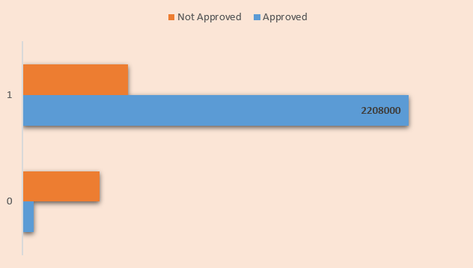
Credit History by Income
Insight:
The no. of loan status approved is high for those applicants who all are earning more and have credit history 1.

Slide 5
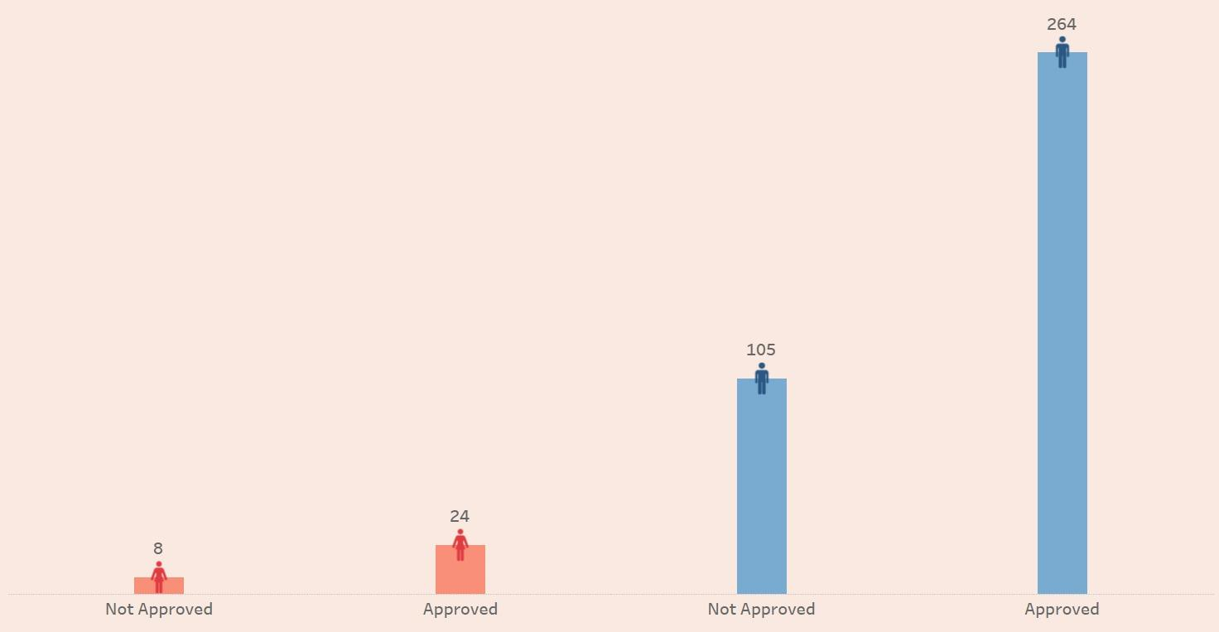
Gender By Loan Status (Married)
Insight:
Highest no. of Loan status approved applicants are male and they are also married.

Slide 6
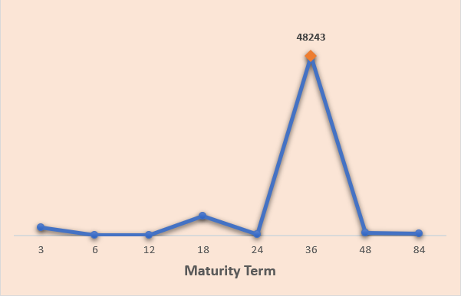
Premium By Maturity
(Married Male)
Insight:
Married and male applicants falling under maturity term 36 are the highest contributors of Premium.

Slide 7

Income & Premium By Dependents
Insight:
Applicants with 0 dependents have more income, also they are paying high premium
cost.

Slide 8
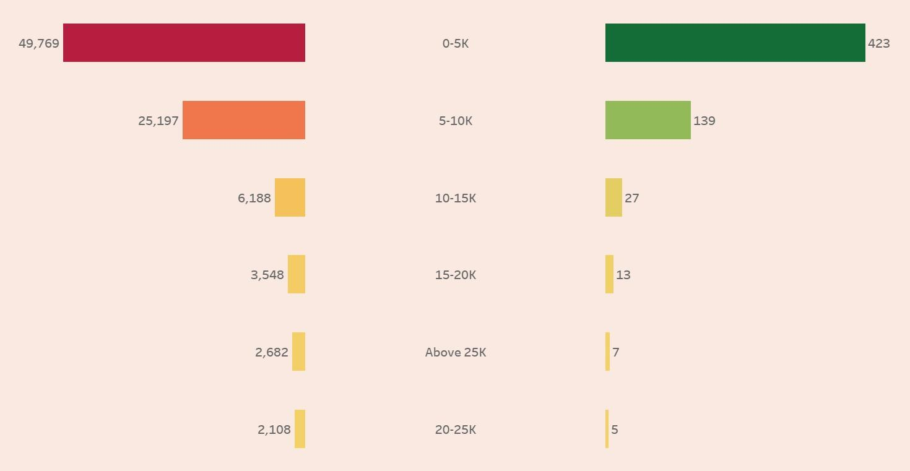
Premium & Applicants By Salary Range
Insight:
The No. of applicants in 0-5K range of income is highest and they are contributing
more in premium.

Slide 9
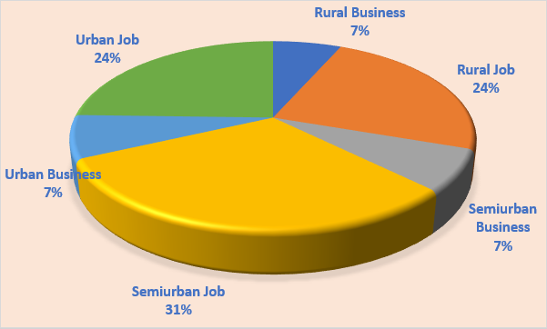
Premium By Branch & Job
Insight:
Applicants doing Job and from Semi urban branch are the highest contributors of Premium.

Slide 10
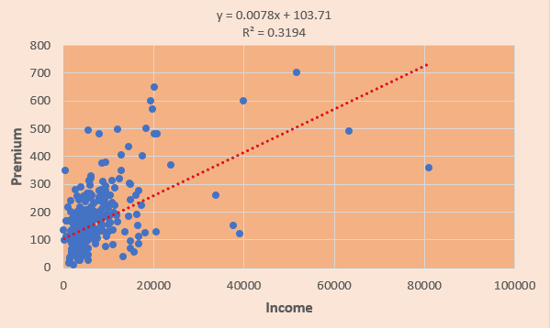
Correlation b/w Premium & Income
Correlation | Income | Premium
Income | 1 | 0.565229
Premium | 0.565229 | 1
Insight:
Moderately positive correlation.

Slide 11
Challenges faced
How to deal with blank/null values in data set – Learned different methods of Data Imputation and then applied suitable method.
How to create Parameter in Tableau with All option for Education, Employment and Branch.
How to create Income Slab/Range
Excel – Used group by feature in Pivot Table.
Power – Used Power Query to insert a new column called Income Range with help of If Else logic.
Tableau – Created a calculated field named Income Range using If Else logic.

Slide 12
Conclusion
Potential customers are those who are male and married with 0-5K income range doing Job belong to semi urban branch.
Other fields to be focus are :
Approved loan status
Credit history 1
0 dependents
Maturity term 36.

Slide 13
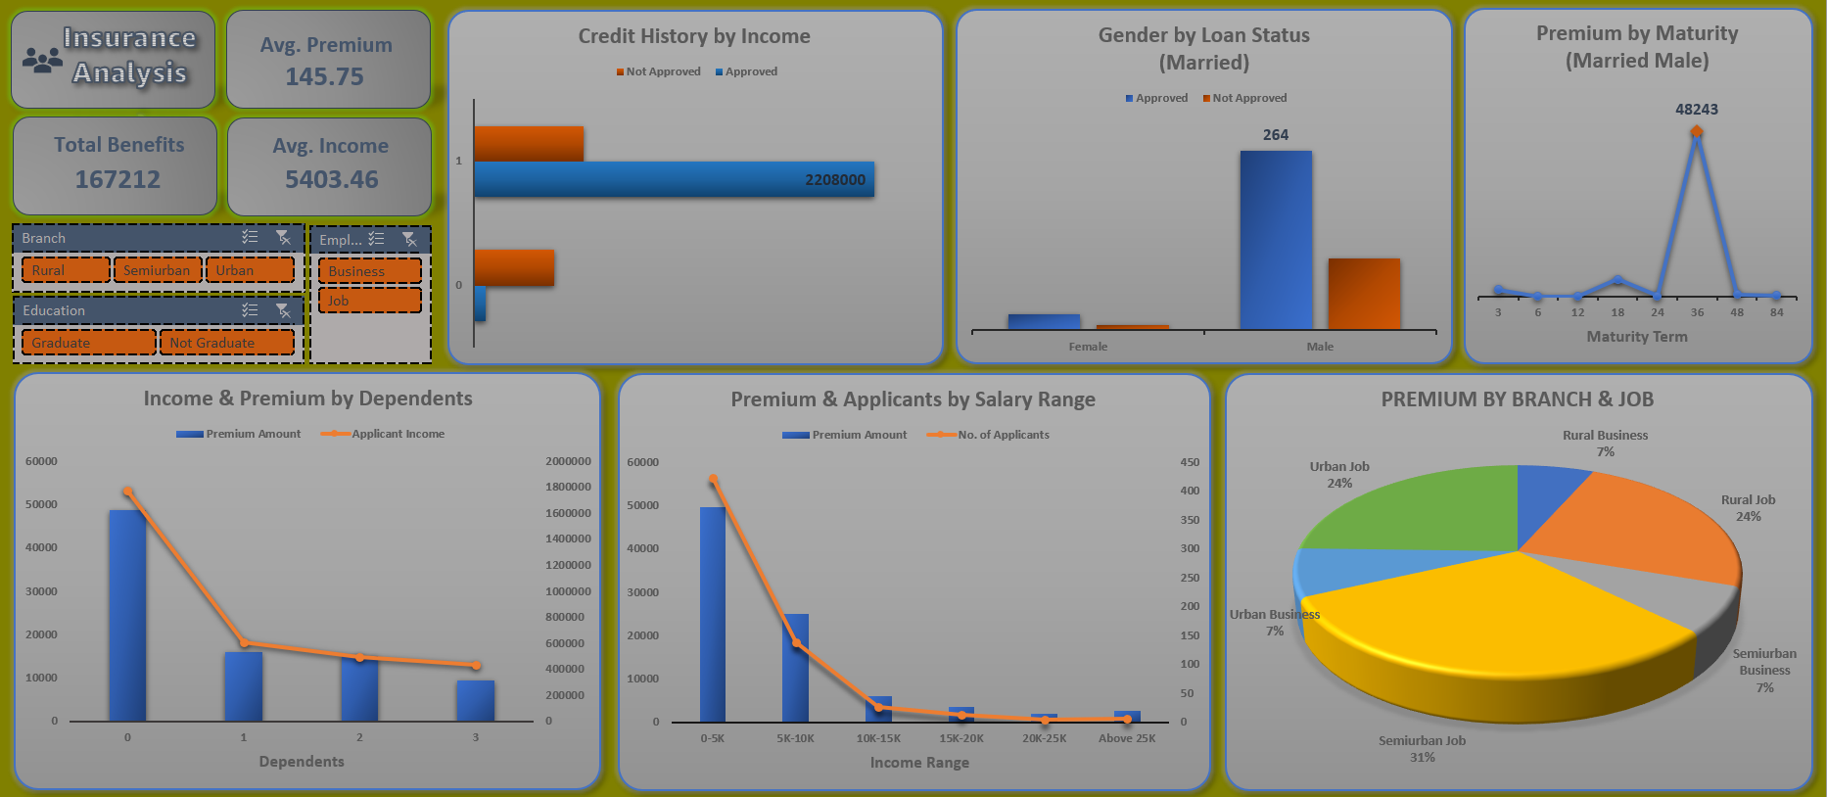
Excel Module Dashboard

Slide 14
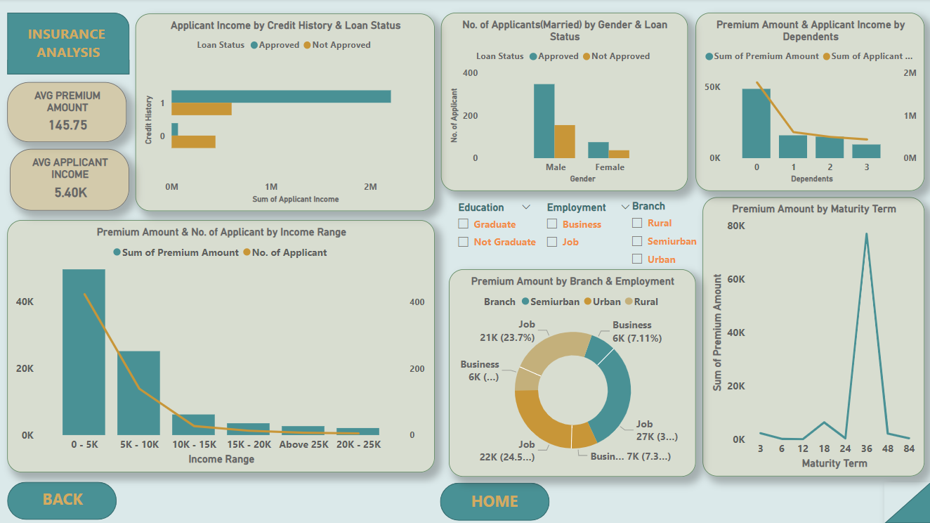
Power BI Module Dashboard

Slide 15
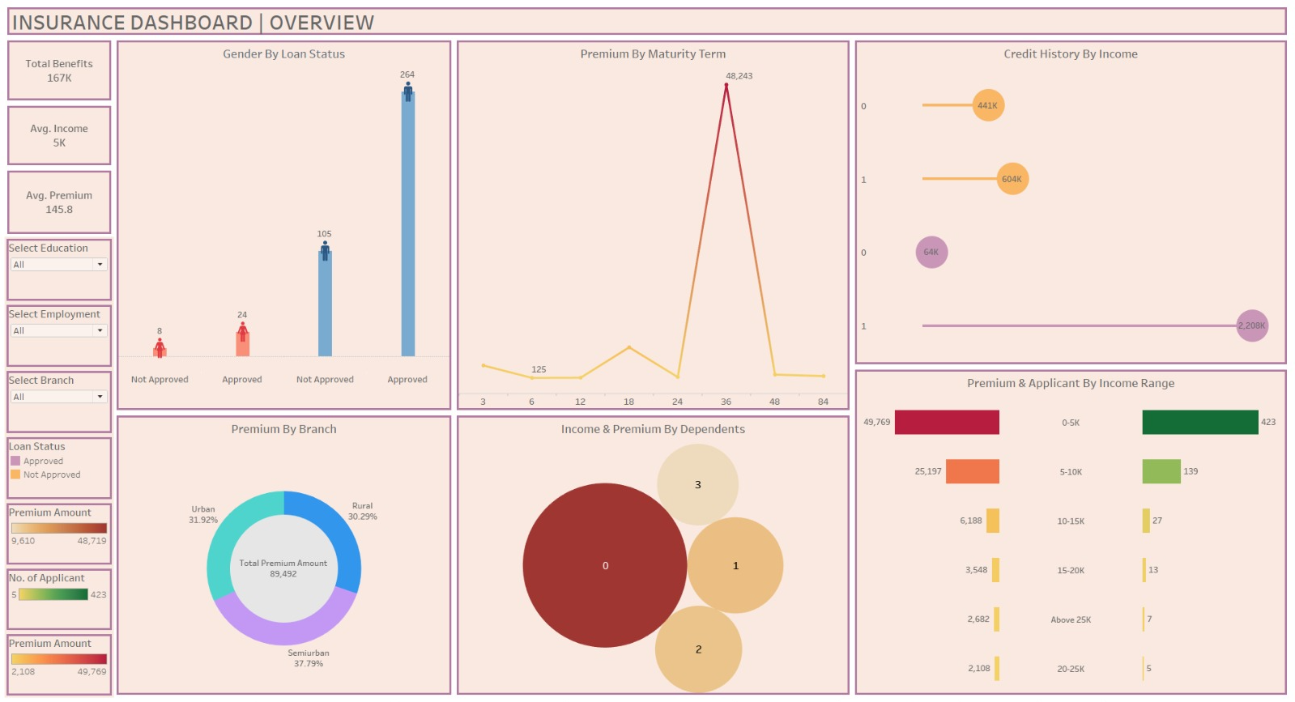
Tableau Module Dashboard

Slide 16
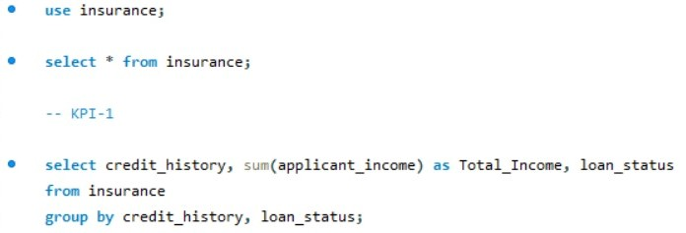
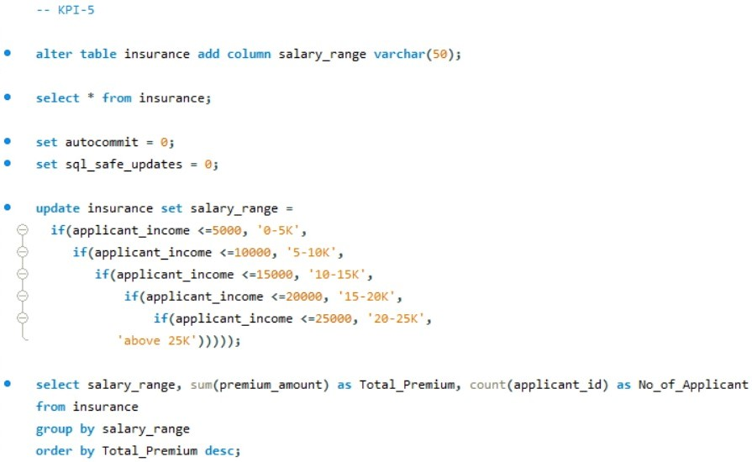
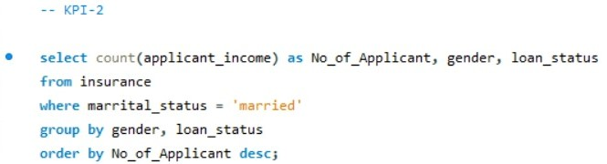
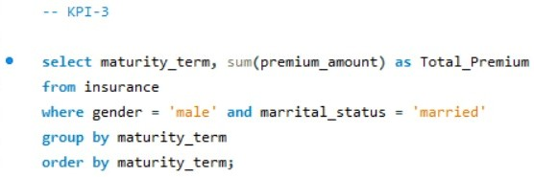
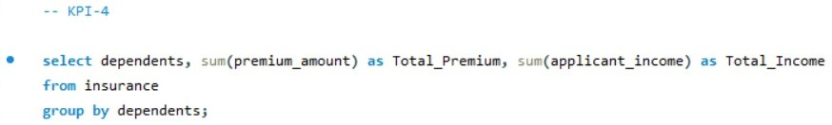
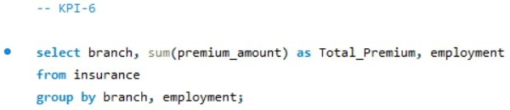
MY SQL Module

Slide 17

Thank You…!!!

